Slide 1
When students sprint: Experiences with Athletic Software Engineering
Philip Johnson
Information and Computer Sciences
University of Hawaii
Honolulu, HI USA

Slide 2


Slide 3
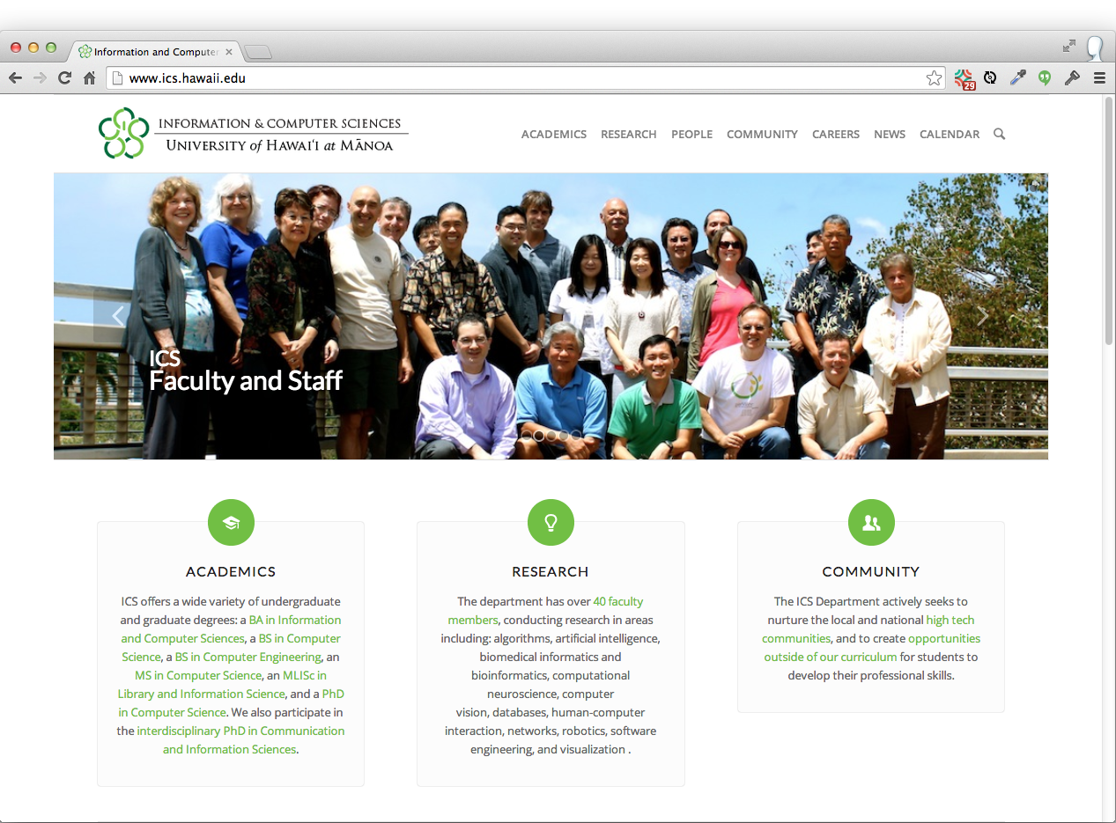

Slide 4
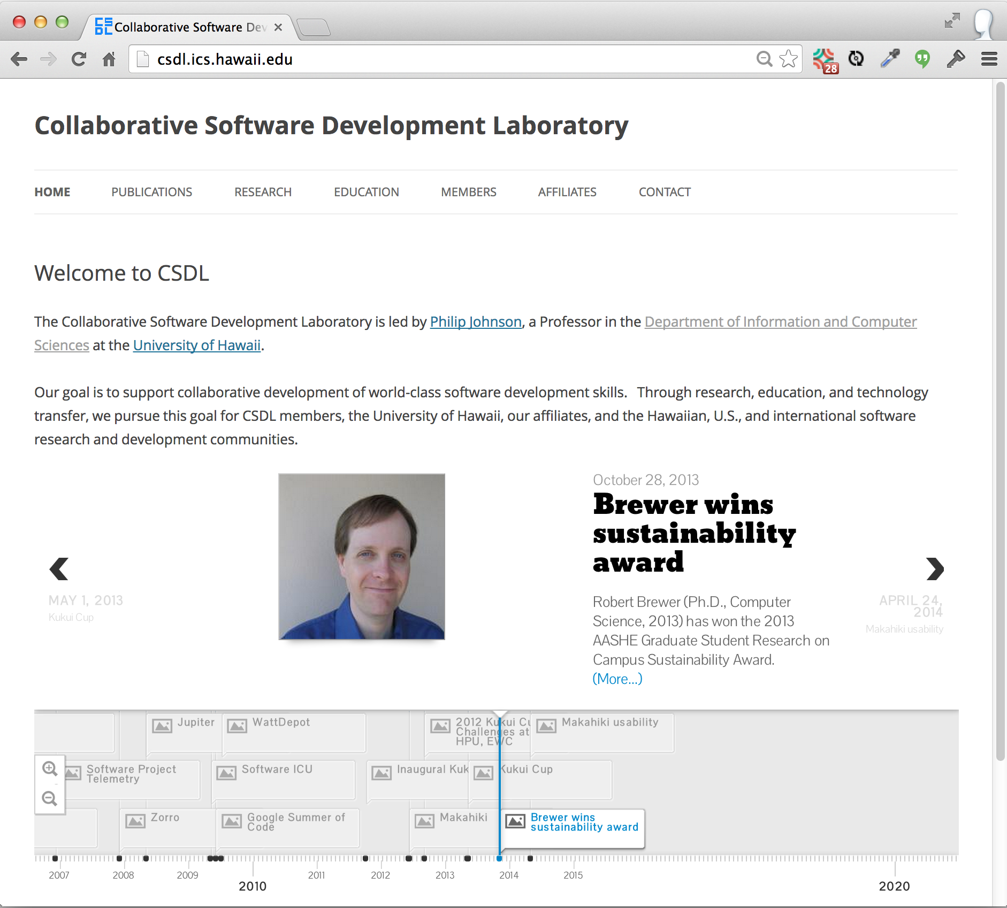

Slide 5
Learning outcomes
New ways to experiment on your students in the classroom
A simple, open source technology for building semi-structured course web sites.

Slide 6
Prelude: Bloom's Taxonomy
Capabilities
Create
Deep
Evaluate
Analyze
Apply
Understand
Remember
Shallow

Slide 7
Prelude: Bloom's Taxonomy
Capabilities
Techniques
Teach others
Create
Deep
Practice by doing
Evaluate
Discussion group
Analyze
Demonstration
Apply
Audio-Visual
Understand
Lecture/Reading
Remember
Shallow

Slide 8
Prelude: Bloom's Taxonomy
Capabilities
Techniques
Retention
Teach others
90%
Create
Deep
Practice by doing
75%
Evaluate
Discussion group
Analyze
50%
Demonstration
Apply
30%
Audio-Visual
20%
Understand
Lecture/Reading
10%
Remember
Shallow

Slide 9

Evolution of my pedagogy

Slide 10
How can I create "deep" learning in my courses?

Slide 11




Approach: Survey textbook + lecture

Slide 12
Result
Approach | Significant strength | Significant weakness
Survey + Lecture | High quality texts | Low engagement

Slide 13
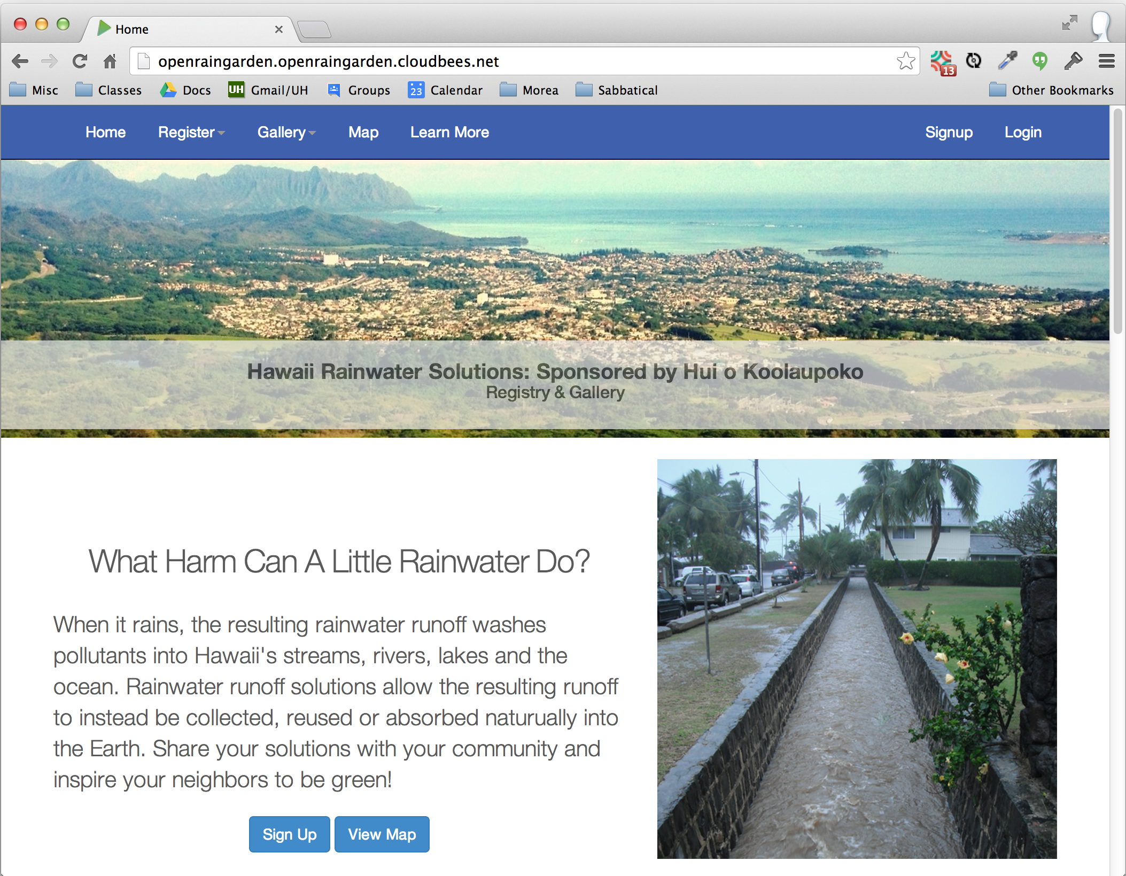
Approach 2: Community projects

Slide 14
Result
Approach | Significant strength | Significant weakness
Survey + Lecture | High quality texts | Low engagement
Community projects | High potential engagement | Variability in engagement

Slide 15
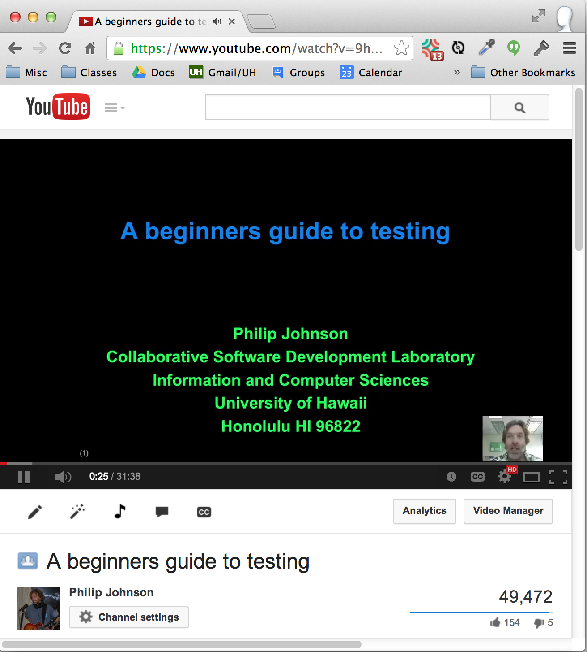
Approach: Flipped classroom

Slide 16
Result
Approach | Significant strength | Significant weakness
Survey + Lecture | High quality texts | Low engagement
Community projects | High potential engagement | Variability in engagement
Flipped classroom | "Active" classrooms | 60 min YouTube videos

Slide 17
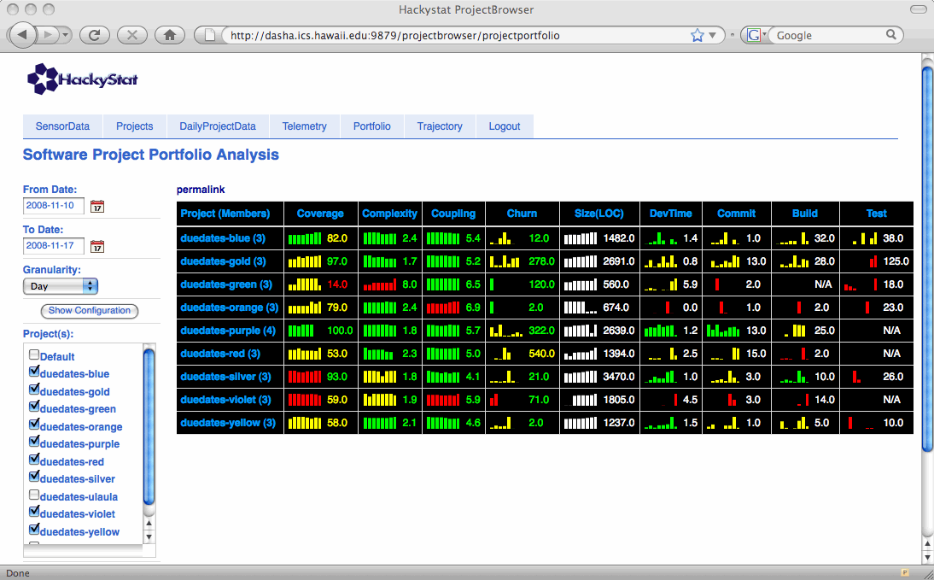
Approach: Super Metrics!

Slide 18
Result
Approach | Significant strength | Significant weakness
Survey + Lecture | High quality texts | Low engagement
Community projects | High potential engagement | Variability in engagement
Flipped classroom | "Active" classrooms | 60 min YouTube videos
Super Metrics | Fine grained insight into developer behavior | Complexity

Slide 19
Approach: Athletic Software Engineering

Slide 20
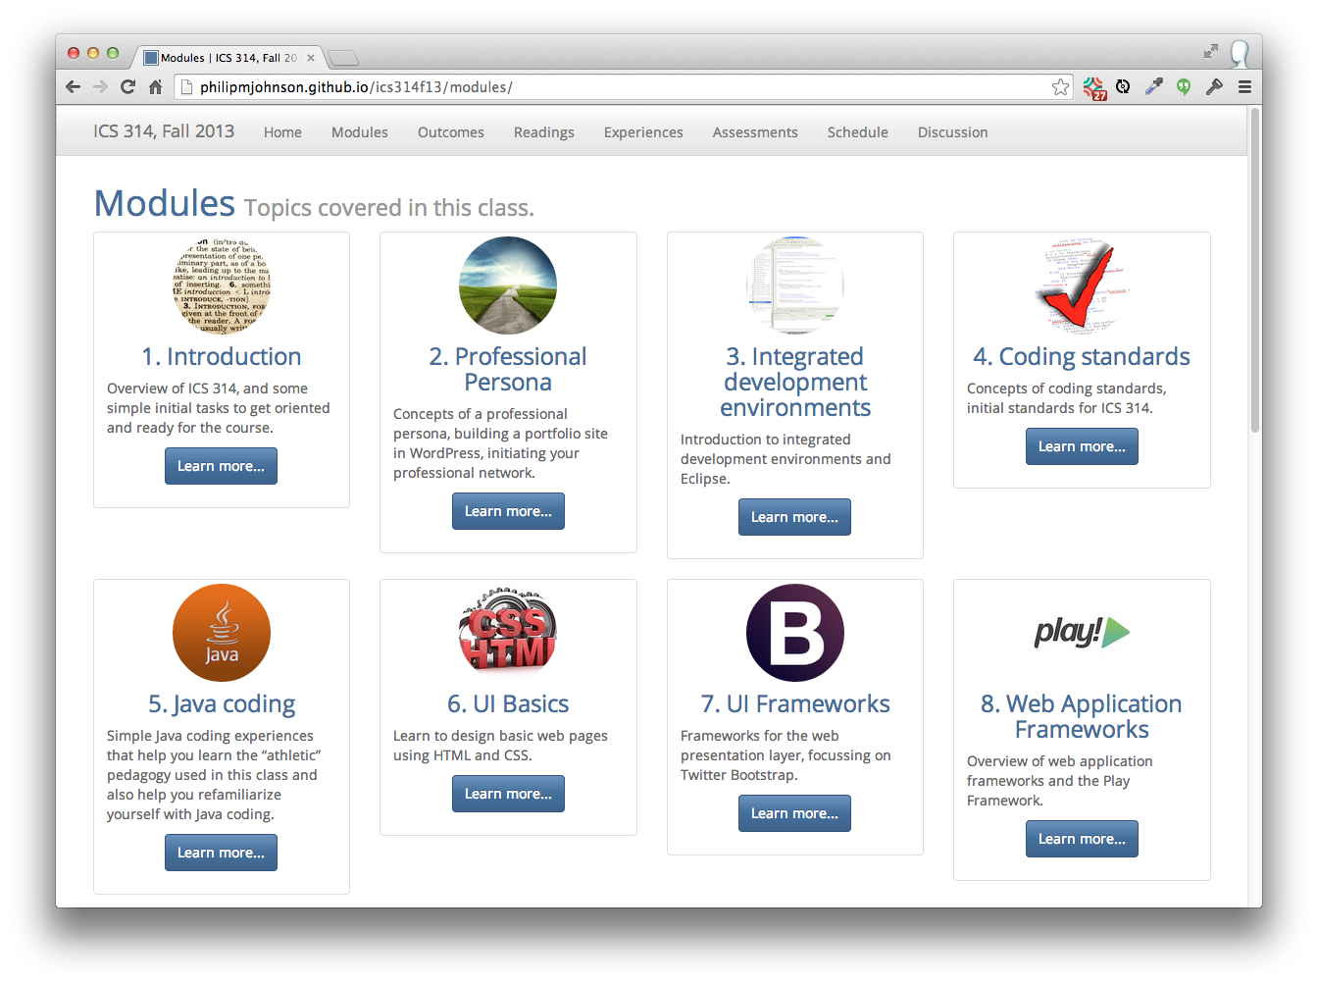

Slide 21
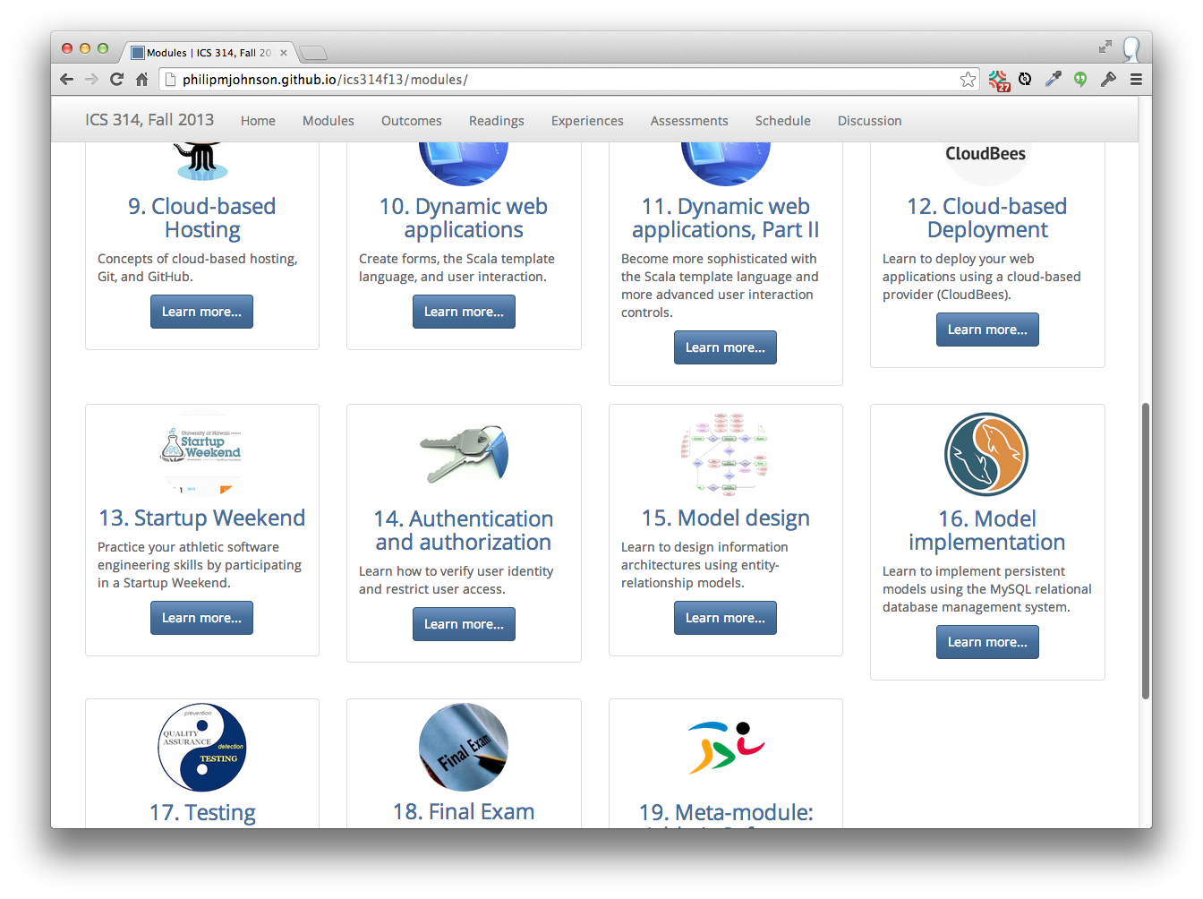

Slide 22
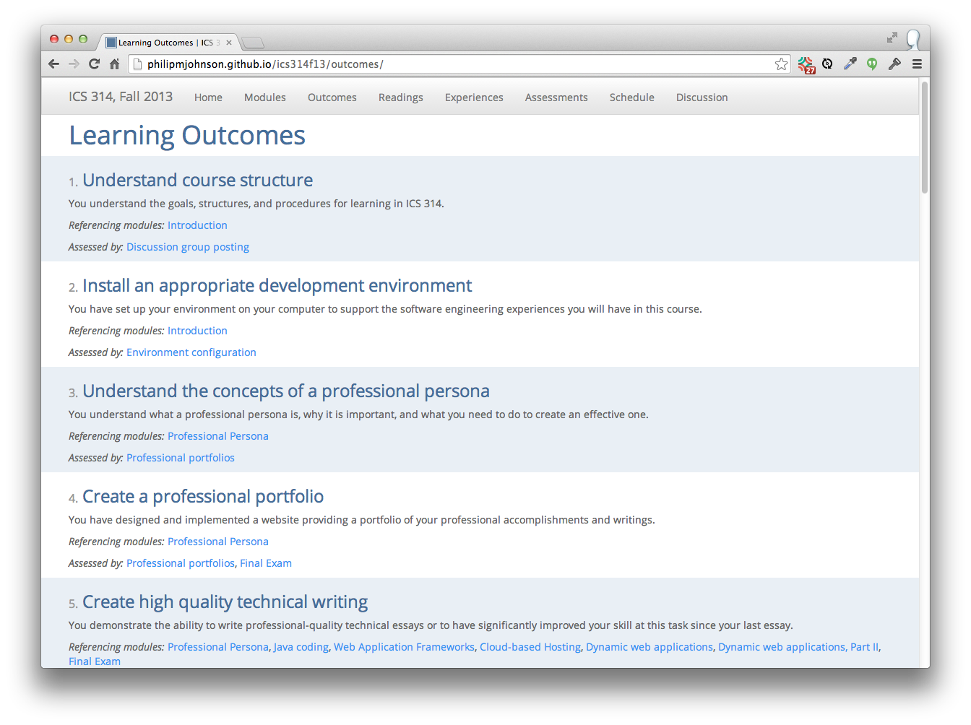

Slide 23
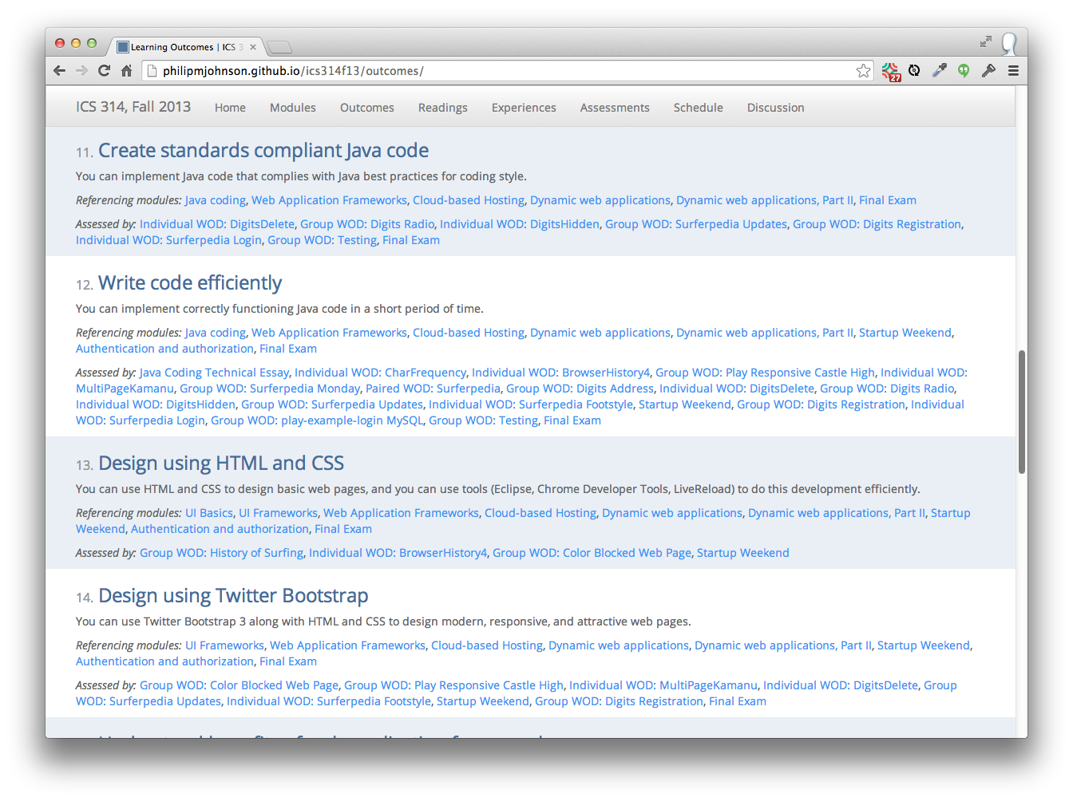

Slide 24
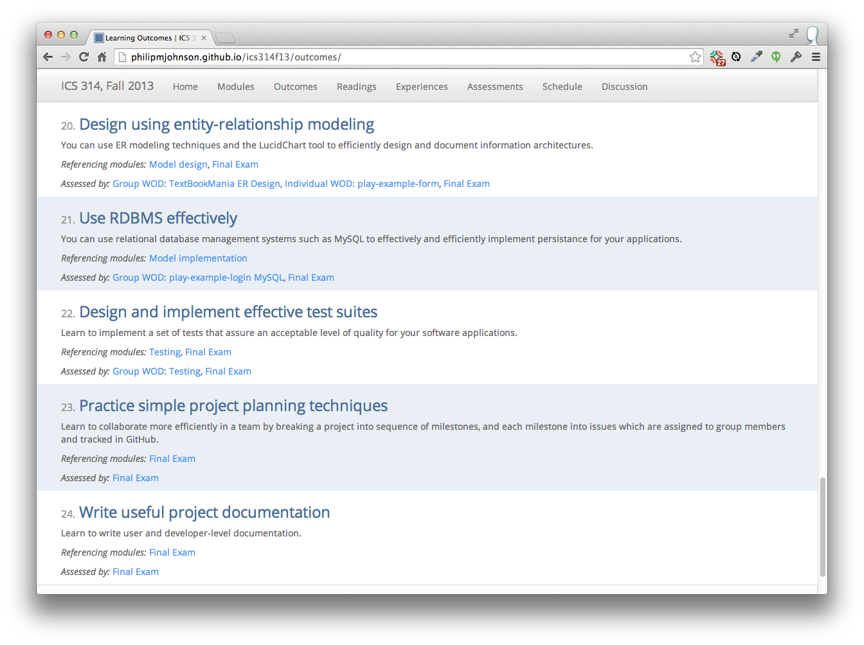

Slide 25
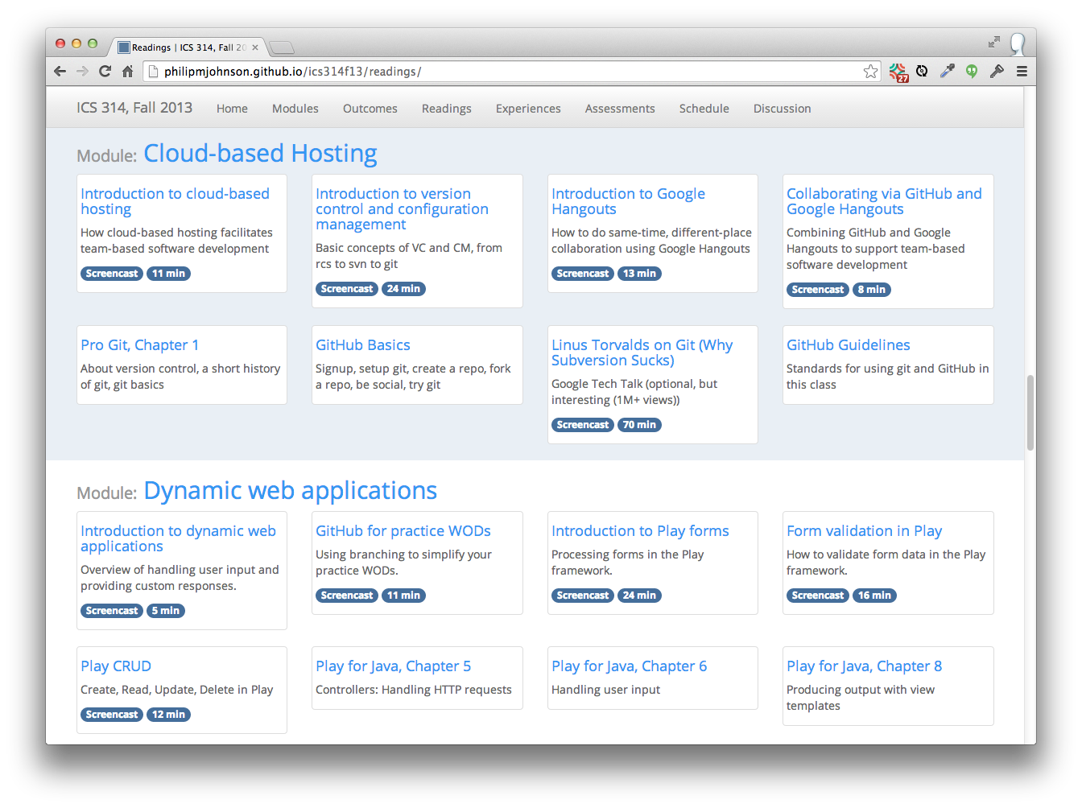

Slide 26
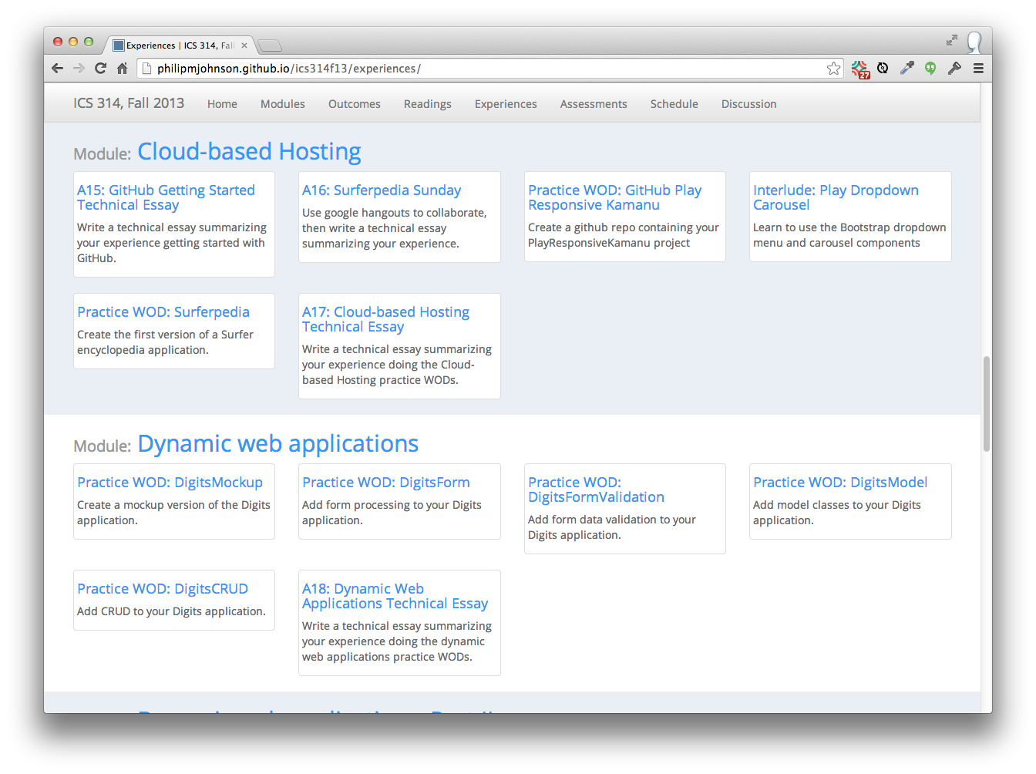

Slide 27
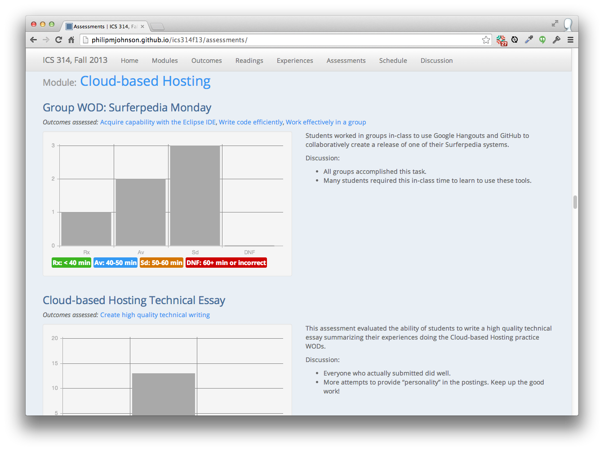

Slide 28
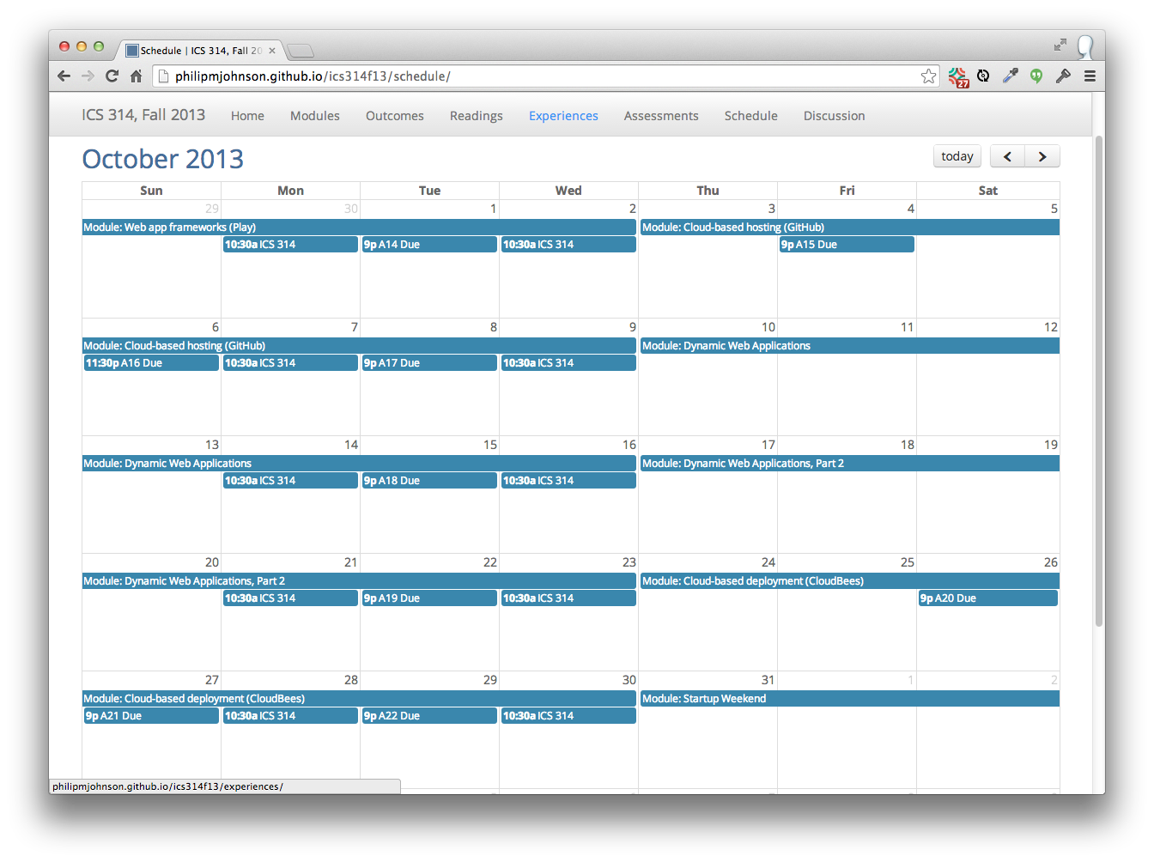

Slide 29
So, where's the "athletics"?

Slide 30
Athletic Software Engineering: The Big Ideas
"Workouts", not "classes"

Slide 31
Athletic Software Engineering: The Big Ideas
No reward for "heroic efforts"

Slide 32
Athletic Software Engineering: The Big Ideas
Organize material into "skills".
"Fluency" with a skill can be tested in <45 minutes.
Instructor demonstrates "fluency" via YouTube videos.

Slide 33
Athletic Software Engineering: The Big Ideas
"DNF" (Did not finish)
No credit if you take too long.

Slide 34
Example: Develop fluency with HTML/CSS

Slide 35
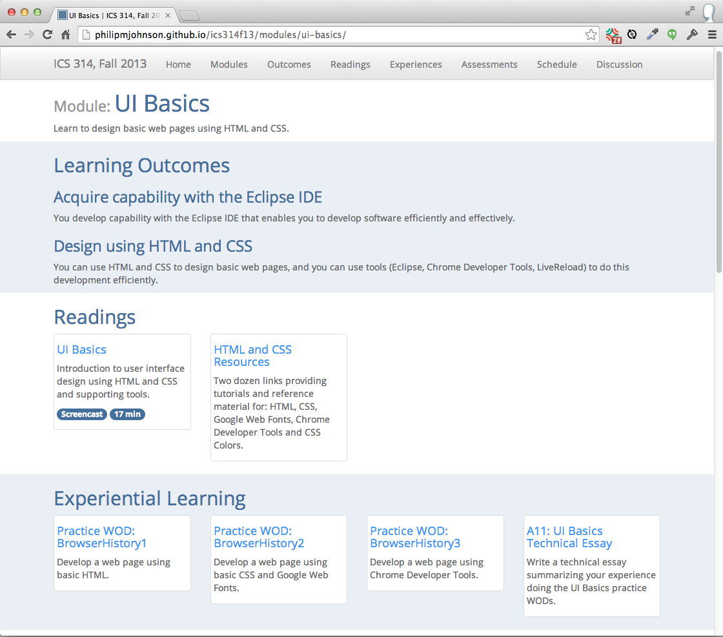

Slide 36
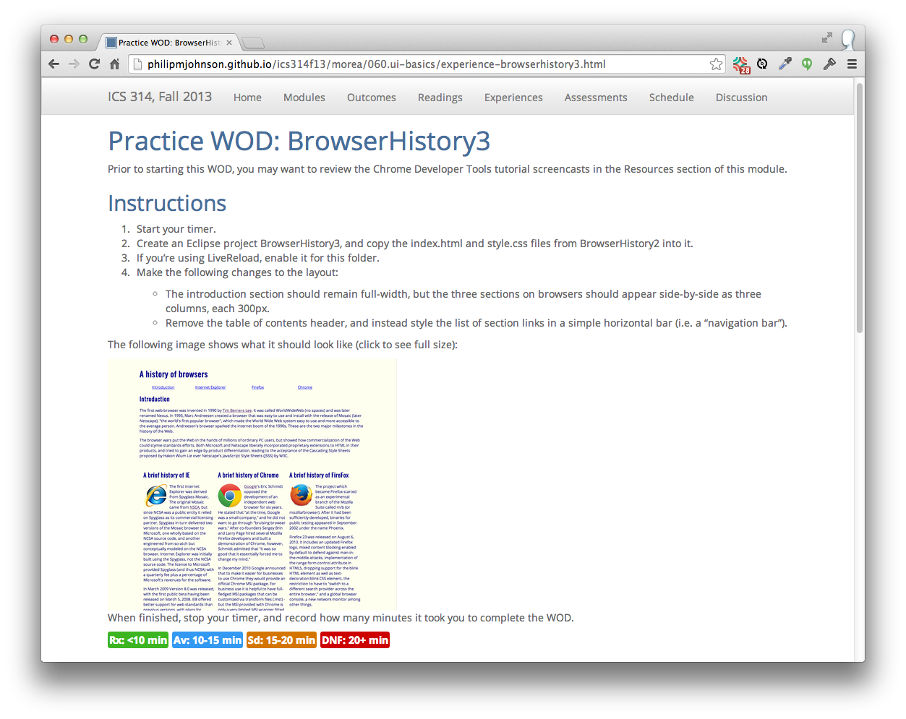

Slide 37
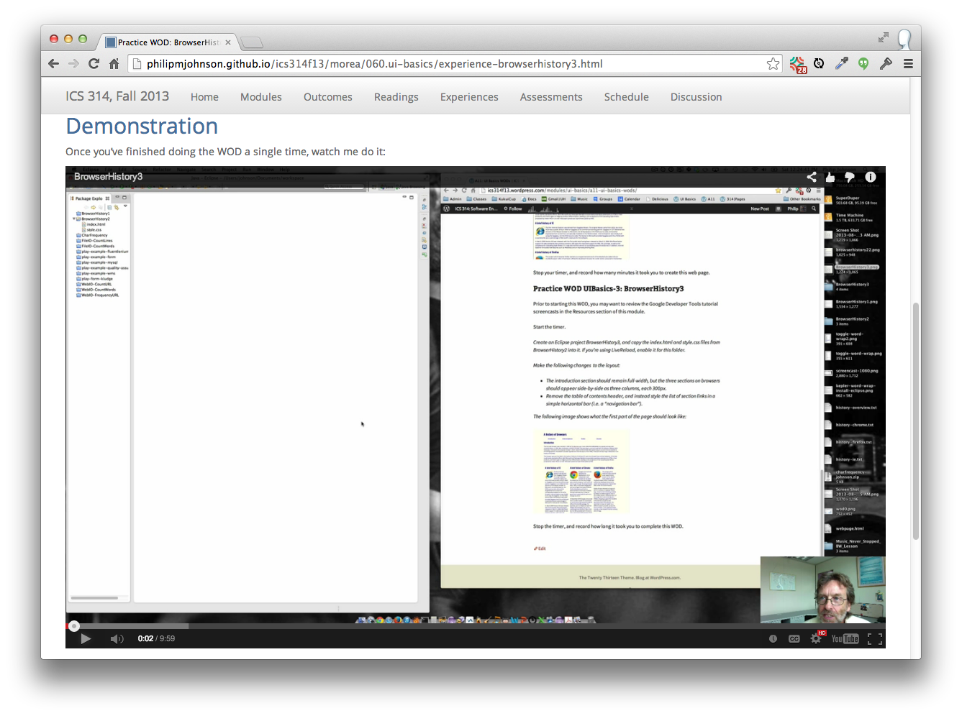

Slide 38
How do you determine if students have achieved "fluency"?

Slide 39
Answer: The "WOD" (Workout of the Day)
Each Wednesday, students take a timed test to see if they have achieved "fluency"
If they do not solve the problem quickly and correctly, they get no credit for the module.

Slide 40
WOD Logistics
How do you accurately time each student in a class of 30?

Slide 41
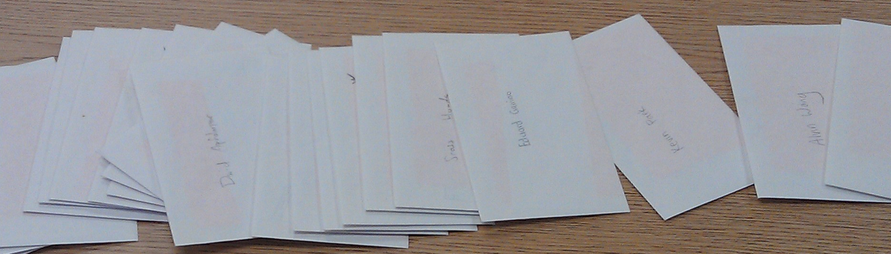
Each student has an envelope
I keep them between classes

Slide 42
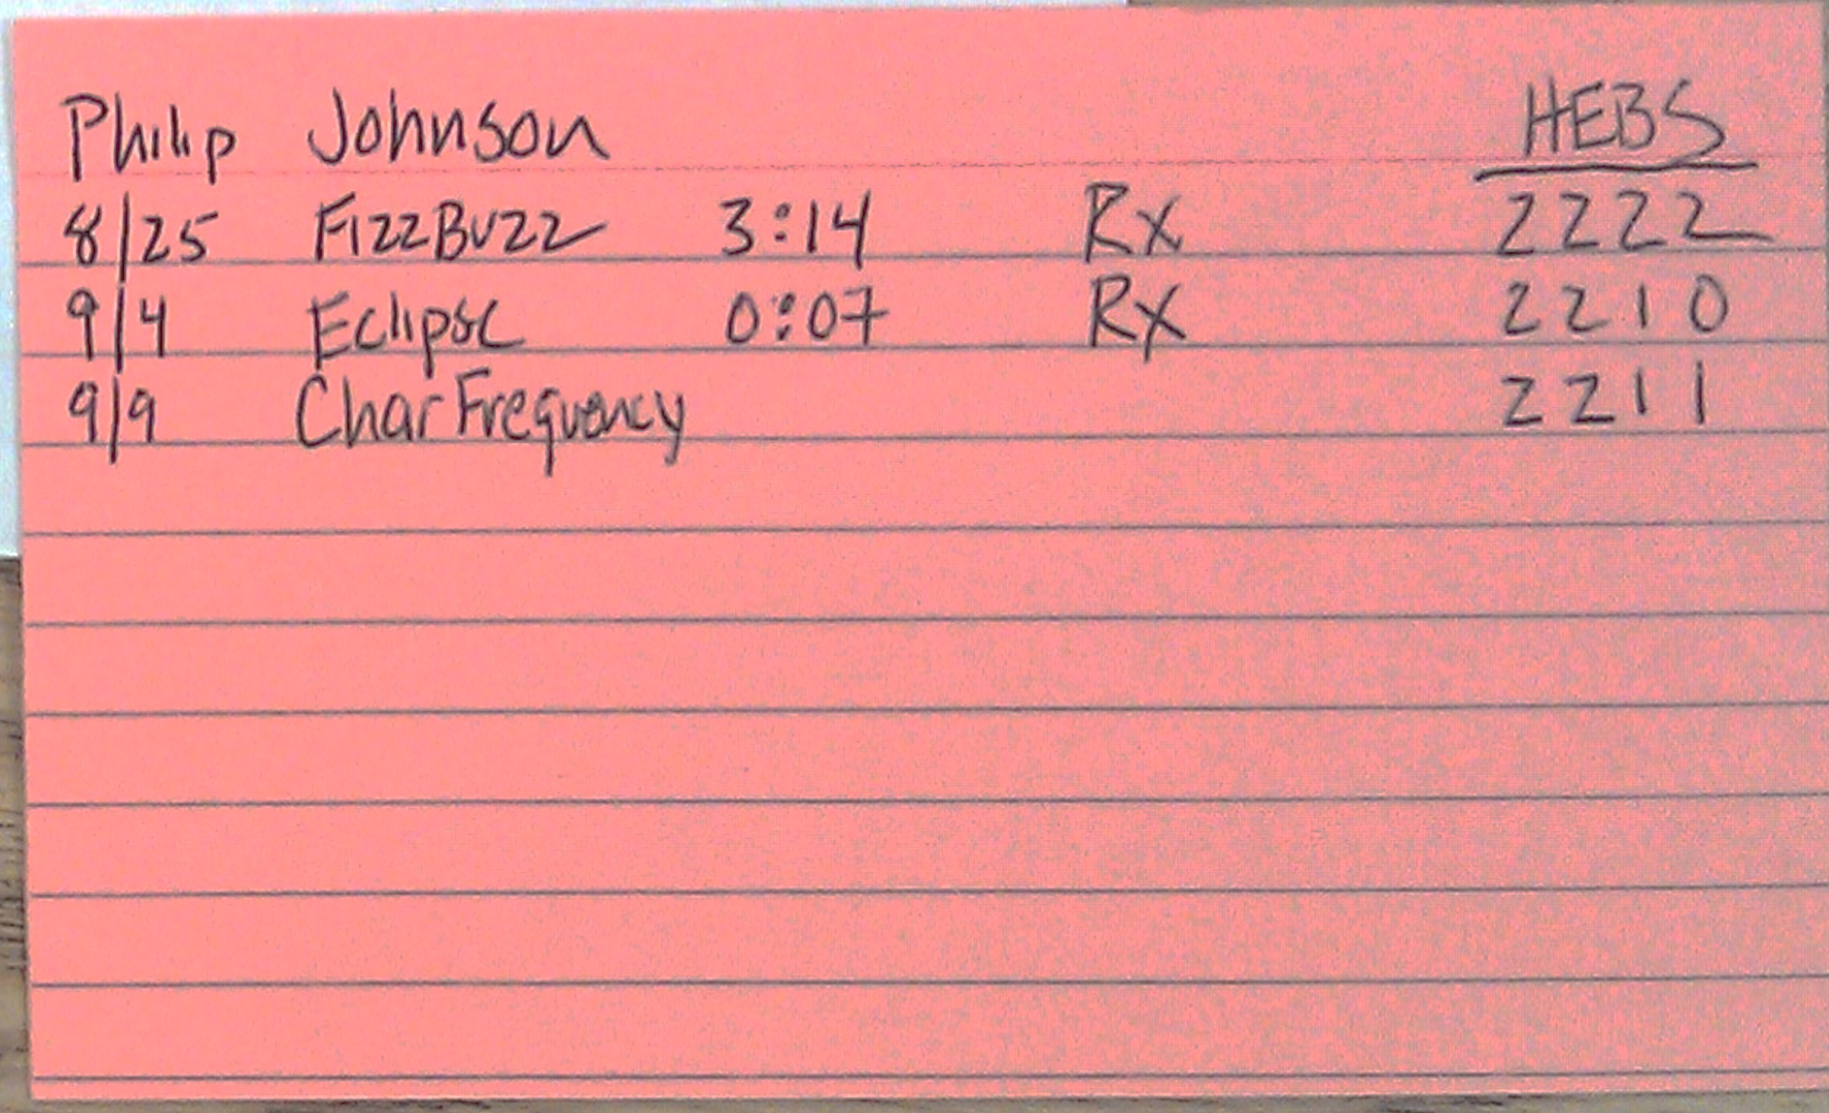
Envelopes contain an index card
Records test results from class

Slide 43
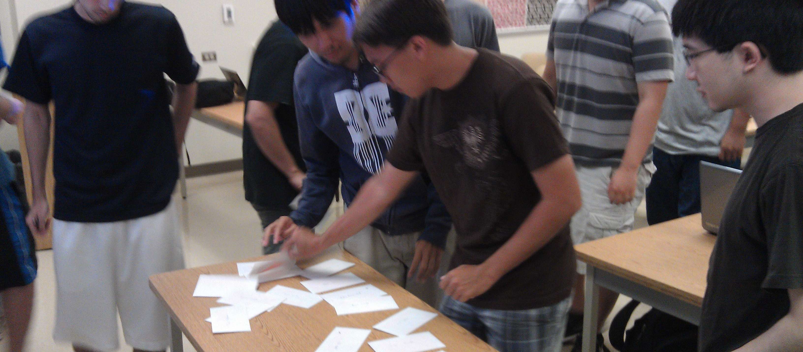
Students get their card before test

Slide 44
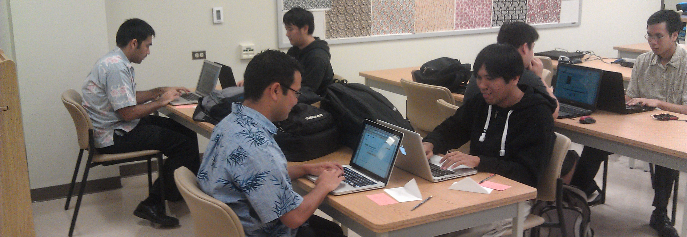
Race against the clock to finish

Slide 45
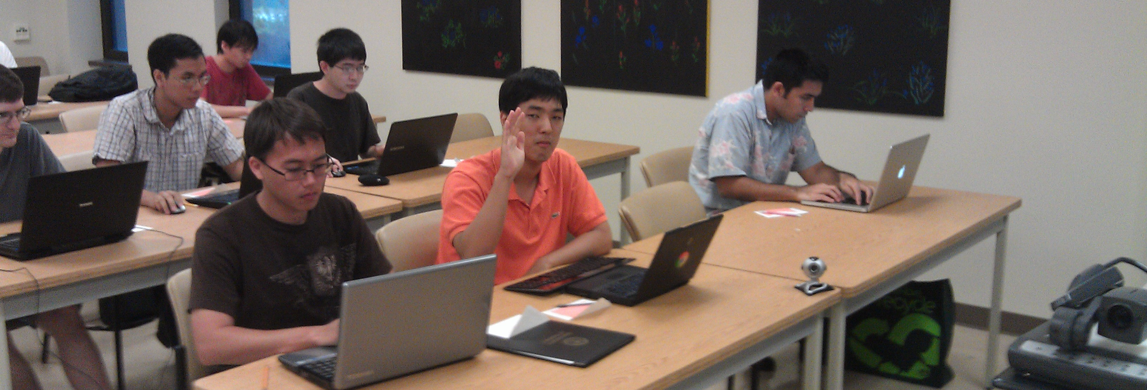
Students raise hand when finished
I record their time and take card

Slide 46
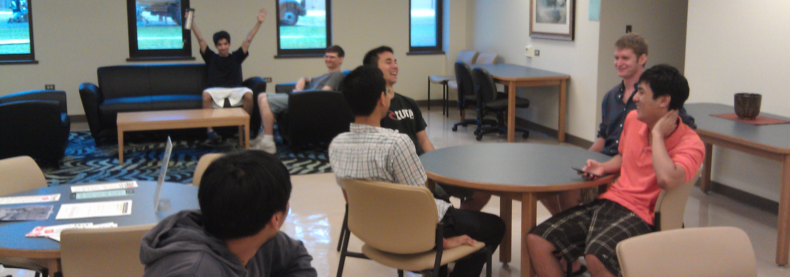
First to finish wait outside class
The "Winners Circle"

Slide 49


Slide 50
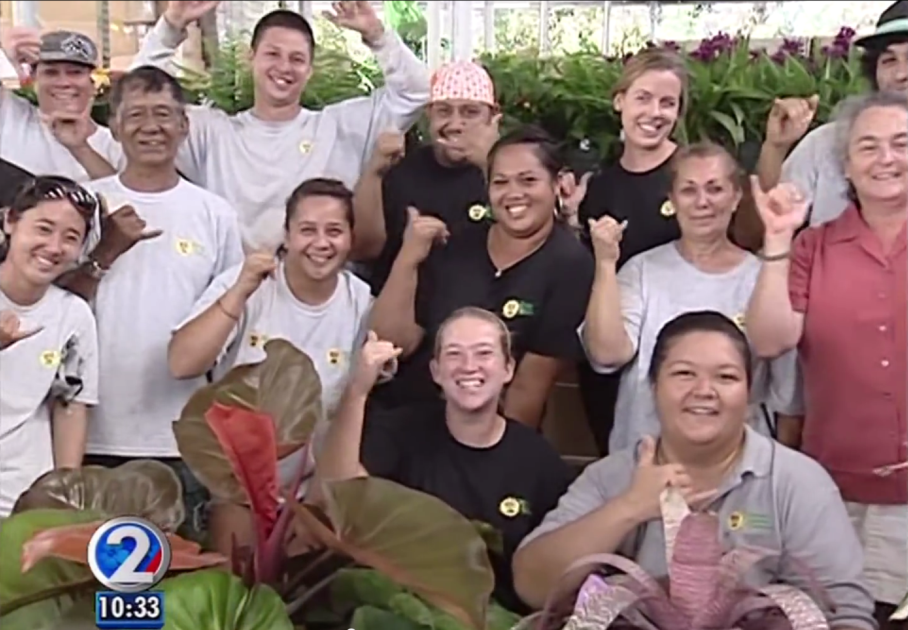

Slide 51
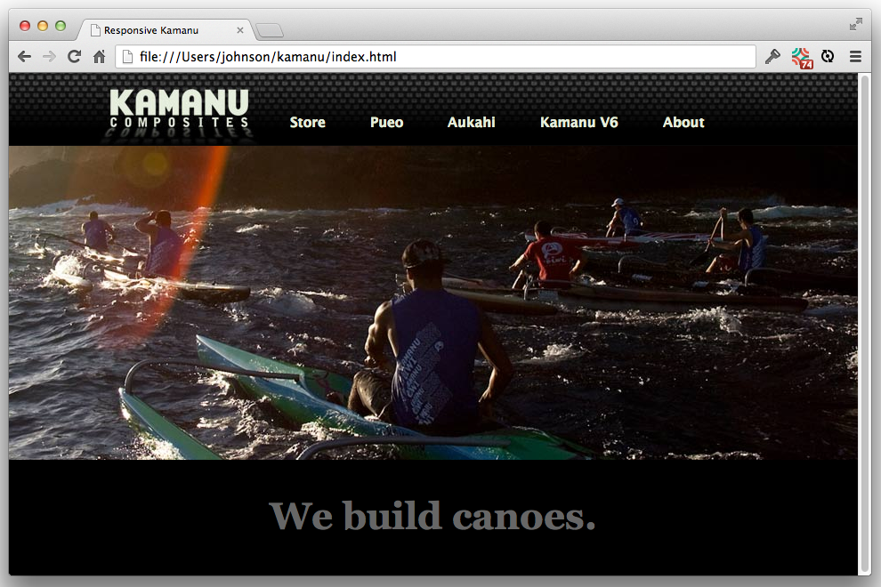
Example CSS/HTML "skill"

Slide 52
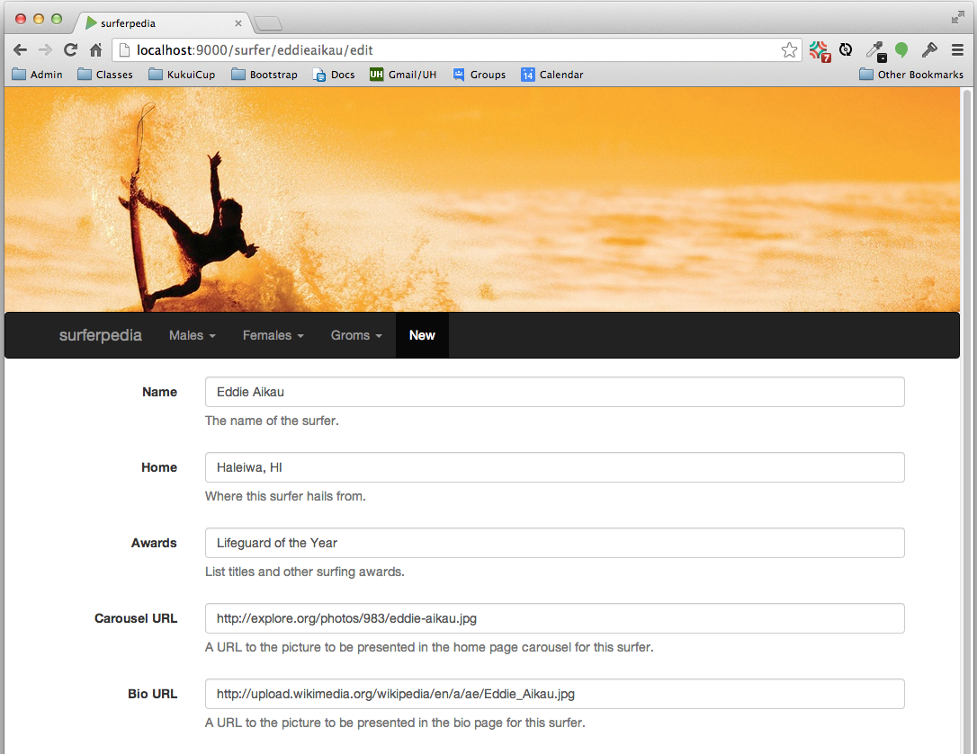
Example Web App "skill"

